Slide 1
Intro to Economics
Jonathan
ASE - Software Engineer
Div. Operation & Technology
NIK: 1918
jonathan.gimin@ocbcnisp.com

Slide 2
Make a choice
You have to make a choice because you cannot be in two places at the same time.

Slide 3
aspect of economics
microeconomics
Macroeconomics
18:09
Study of CHOICE of individual or business, the way market react to it and the influence of government
Study of PERFORMANCE of economics of national (country) or global (world)
Example:
What do you buy for eat this morning?
Do you use toll road or normal road?
Do you buy the new EV car?
Example:
Why does it’s hard to land a job nowadays than previous quarter?
Geopolitical situation, trade war
The Fed / BI Interest Rate

Slide 4
Self decision
People make decision based on cost and benefit (trade off)
Example: When deciding between buying a new phone or a motorcycle, individuals evaluate which is more necessary at the moment.

Slide 5

Government decision
Incentives/Subsidies shape behavior in an economy.
But first, why we really need Incentives/Subsidies?

Slide 6
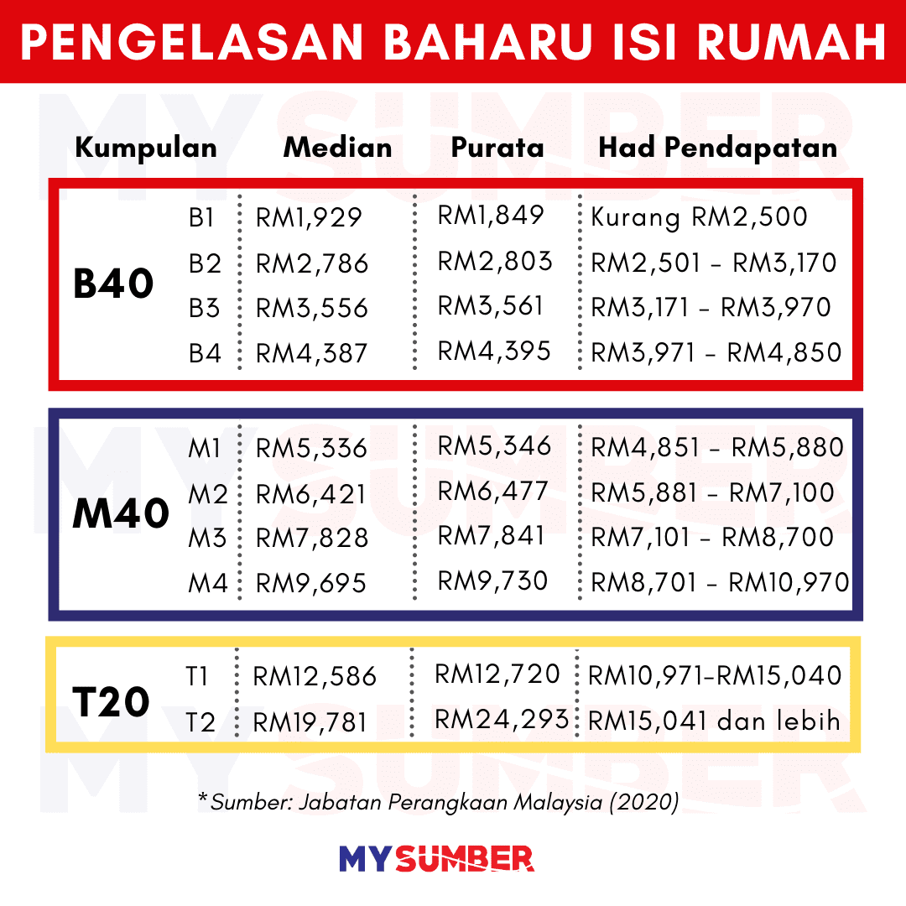
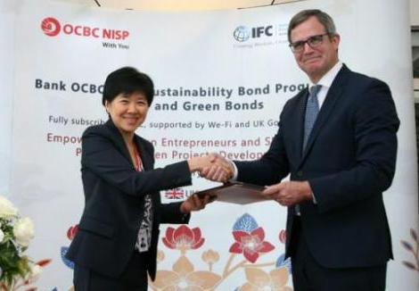
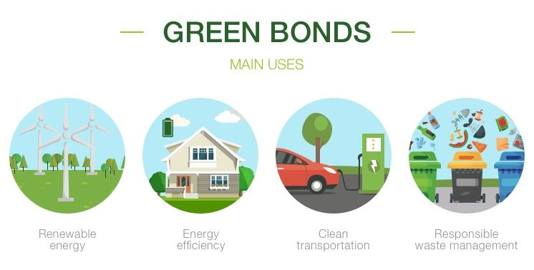
2 major reasons:
Support Low-Income Groups Government pledge to serve public by giving subsidy to essential goods like fuel, food, or housing to make them affordable for low-income citizens.
Encourage Certain Industries Renewable energy like solar panel and electric vehicles that emit less carbon

Slide 7
Factor of production
land
labour
capital
entrepreneurship
Places, include Natural Resources
Effort that human contribute (value added)
Money, Machine, tools, Intellectual Property
Management of the rest of three

Slide 8
Chinese Proverbs
不要贫穷,没有人给你钱
Bù yào pín qióng, méi yǒu rén gěi nǐ qián
Don't Be Poor,
No One Will Give You Money

Slide 9
THANKS

